Slide 1
Heart Disease Diagnostic Analysis

Slide 2
Introduction
Health is a critical aspect of human life, and understanding heart disease risk factors is essential for preventive measures.
This project analyzes heart disease diagnostic data to extract meaningful insights and build predictive models.
Heart Disease Diagnostic Analysis

Slide 3
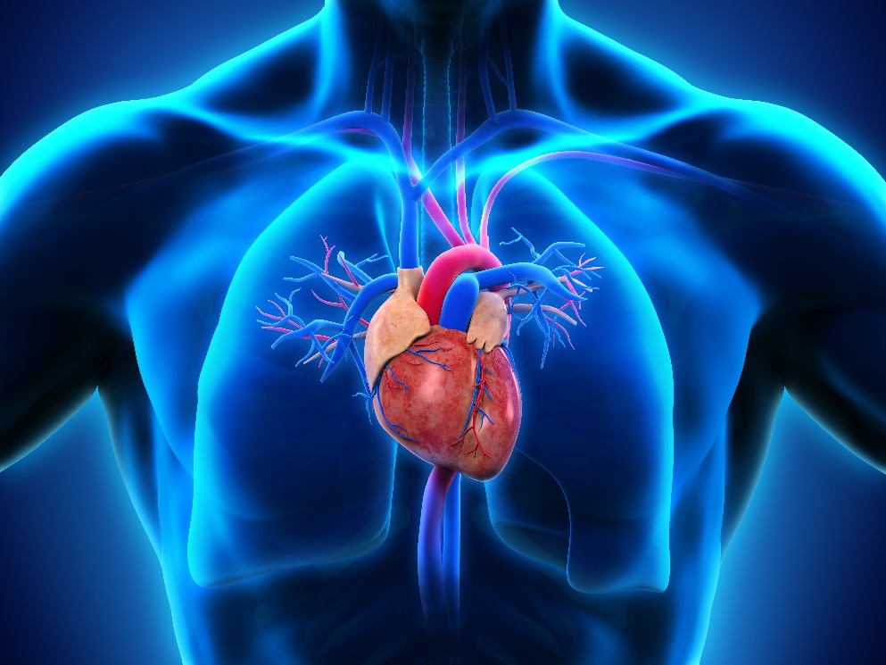
Objective
Analyze heart disease diagnostic data.
Perform exploratory data analysis (EDA).
Build predictive models.
Visualize key insights using Python and Tableau.
Heart Disease Diagnostic Analysis

Slide 4
Dataset Description
ETL Process:
Extract:
Load the dataset into Python.
Transform:
Clean the data, handle missing values, and perform necessary transformations.
Load:
Store the cleaned and transformed data for further analysis.
Attribute | Description
age | Age of patient
sex | Gender of the patient (1 = male, 0 = female)
cp | Chest pain type (0-3)
target | Diagnosis of heart disease (1 = disease; 0 = no disease)
thalach | Maximum heart rate achieved
chol | Serum cholesterol in mg/dl
fbs | Fasting blood sugar
Heart Disease Diagnostic Analysis

Slide 5
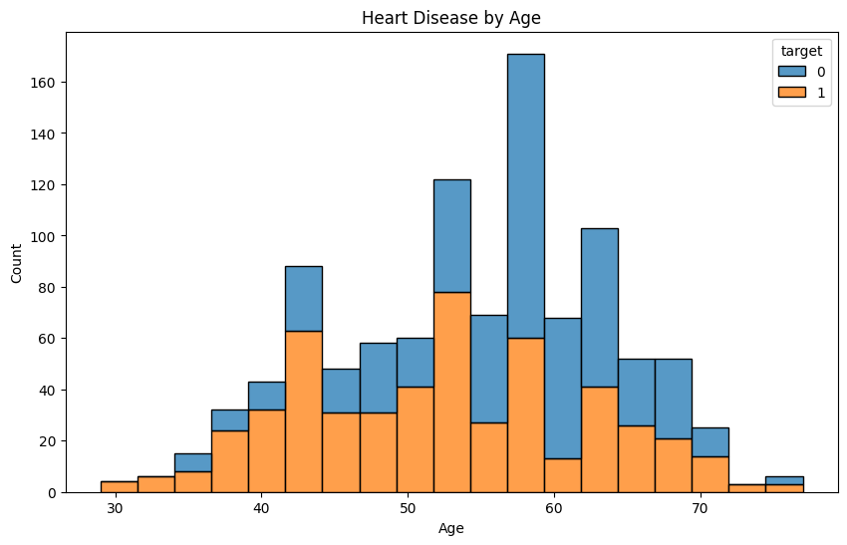
Exploratory Data Analysis
Summary statistics.
Heart disease rates.
Heart disease by gender.
Heart disease by age.
Comparison of attributes.
Heart Disease Diagnostic Analysis

Slide 6
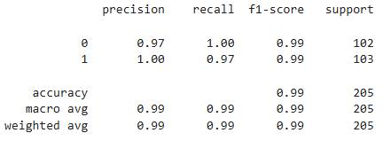
Predictive Modeling
Model selection (e.g., Logistic Regression, Decision Trees).
Model evaluation metrics (accuracy, precision, recall).
Best-performing model and its fine-tuning.
Heart Disease Diagnostic Analysis

Slide 7
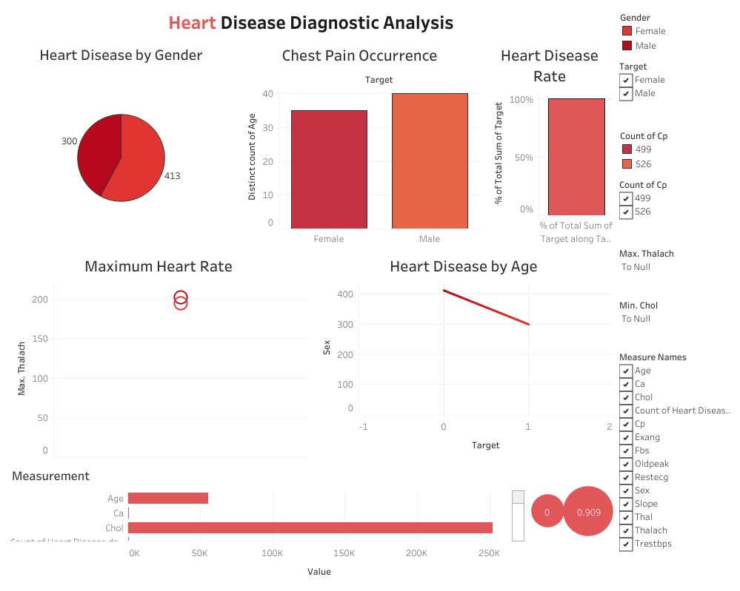
Visualization
Heart Disease Diagnostic Analysis

Slide 8
Thank You !
Tableau Public

